Slide 1

Student Depression Analysis using PySpark
A Data-Driven Approach to Student Mental Health

Slide 2
Introduction
Analyze mental health and depression trends among students.
Dataset includes: Sleep Duration, Work Pressure, Study Hours, Academic Pressure, Gender, Age, and Depression Status.
Goal: Identify at-risk students and recommend personalized wellness programs.
Tools: PySpark, SQL, RDD, Matplotlib, Seaborn.
Key Steps: Data Cleaning → Analysis → Recommendations → Evaluation → Visualization.
Importance: Data-driven mental health support helps improve student well-being and academic performance.

Slide 3


Libraries and Setup
Install PySpark and PyDrive
Set up Java environment

Slide 4
Spark Session
Entry point for Spark
Config shuffle partitions for performance
from pyspark.sql import SparkSession
spark = SparkSession.builder \
.appName("StudentDepressionAnalysis") \
.config("spark.sql.shuffle.partitions", "8") \
.getOrCreate()
print("✅ Spark Session Started")
print("Spark Version:", spark.version)

Slide 5

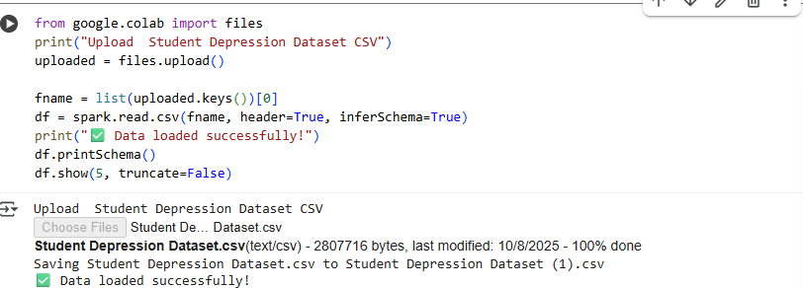
Load Dataset
Upload CSV
Spark reads structured DataFrame

Slide 6

Remove missing values
Rename columns for SQL-friendly format
Remove missing values
Rename columns for SQL-friendly format
df = df.na.drop()
for old_col in df.columns:
new_col = old_col.strip().replace(" ", "_").replace("/", "_").replace("?", "")
df = df.withColumnRenamed(old_col, new_col)
Data Cleaning
Remove missing values
Rename columns for SQL-friendly format
df = df.na.drop()
for old_col in df.columns:
new_col = old_col.strip().replace(" ", "_").replace("/", "_").replace("?", "")
df = df.withColumnRenamed(old_col, new_col)

Slide 7

Create a temporary SQL view
02
Create SQL Table
df.createOrReplaceTempView("students")

Slide 8
Statistics
Count total students
Average sleep, CGPA, study hours
spark.sql("""
SELECT
COUNT(*) AS total_students,
AVG(Sleep_Duration) AS avg_sleep,
AVG(CGPA) AS avg_cgpa,
AVG(Work_Study_Hours) AS avg_study_hours
FROM students
""").show()
10%
20%
70%

Slide 9
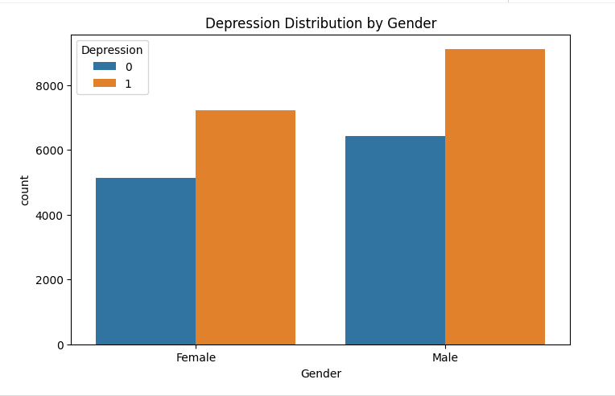
Depression Distribution
Count students with/without depression
Calculate percentages
numeric_cols = [f.name for f in df.schema.fields if str(f.dataType) in ('IntegerType','DoubleType')]
for i in range(len(numeric_cols)):
for j in range(i+1, len(numeric_cols)):
c1, c2 = numeric_cols[i], numeric_cols[j]
corr_value = df.stat.corr(c1, c2)
print(f"Correlation between {c1} and {c2}: {corr_value:.2f}")

Slide 10
Recommendation System (SQL)
Recommend programs based on sleep, work, and academic pressure
recommendations = spark.sql("""
SELECT
id AS ID,
Gender,
Age,
Sleep_Duration,
Work_Pressure,
Work_Study_Hours AS Study_Hours,
Academic_Pressure,
CASE
WHEN Sleep_Duration < 5 THEN 'Recommend Sleep Hygiene Program'
WHEN Work_Pressure > 3 THEN 'Recommend Stress Counseling'
WHEN Academic_Pressure > 3 THEN 'Academic Support and Mentorship'
ELSE 'Regular Wellness Check'
END AS Recommended_Program
FROM students
""")
recommendations.show(10, truncate=False)

Slide 11
Risk Scoring
Map sleep to numeric
Calculate Risk Score for each student
from pyspark.sql.functions import when, col
df = df.withColumn(
"Sleep_Duration_Numeric",
when(col("Sleep_Duration") == "Less than 5 hours", 4.0)
.when(col("Sleep_Duration") == "5-6 hours", 5.5)
.when(col("Sleep_Duration") == "7-8 hours", 7.5)
.when(col("Sleep_Duration") == "More than 8 hours", 9.0)
.otherwise(None)
)
df = df.withColumn(
"RiskScore",
col("Sleep_Duration_Numeric") * -1 +
col("Work_Pressure") * 2 +
col("Academic_Pressure") * 2 +
col("Work_Study_Hours") * 0.5
)

Slide 12
High, Moderate, Low risk → Recommended program
df.createOrReplaceTempView("students_risk")
risk_recommendations = spark.sql("""
SELECT *,
CASE
WHEN RiskScore >= 10 THEN 'High Risk: Intensive Counseling + Mentorship'
WHEN RiskScore >= 5 THEN 'Moderate Risk: Stress & Academic Support'
ELSE 'Low Risk: Regular Wellness Check'
END AS Recommended_Program
FROM students_risk
""")
risk_recommendations.show(10, truncate=False)
02
Risk Classification

Slide 13
RDD Mapping
Map each student to risk label using RDD
rdd = risk_recommendations.rdd
rdd_mapped = rdd.map(lambda row: (
row.id,
row.RiskScore,
"High Risk" if row.RiskScore >= 10 else "Moderate Risk" if row.RiskScore >= 5 else "Low Risk"
))
for item in rdd_mapped.take(10):
print(item)

Slide 14
Window Function Ranking
Rank students by Work Pressure percentile
from pyspark.sql.window import Window
from pyspark.sql.functions import percent_rank
windowSpec = Window.orderBy(col("Work_Pressure").desc())
df = df.withColumn("WorkPressureRank", percent_rank().over(windowSpec))

Slide 15
Evaluation
Precision, MRR, Coverage
from sklearn.metrics import precision_score, classification_report
import pandas as pd
recommendations_pd = pd.DataFrame({
"ID": [1, 2, 3, 4],
"Recommended_Program": ["High Stress Counseling", "Regular Wellness Check", "Sleep Hygiene Program", "Regular Wellness Check"]
})
recommendations_pd['Actual_Program'] = ["High Stress Counseling", "Sleep Hygiene Program", "Sleep Hygiene Program", "Regular Wellness Check"]
precision = precision_score(recommendations_pd['Actual_Program'], recommendations_pd['Recommended_Program'], average='macro')
print(f"Precision: {precision:.4f}")

